Slide 1
OLS-2: GitHub
Natabona H.

Slide 2
AIM: Learning points
how to create a GitHub account
how to create a GitHub repository
writing in markdown
how to create a README file
how to enable a small website via GitHub
how to manage issues and labels
how to submit changes via Pull Request

Slide 3
What is GitHub? ☺
A platform: you can work collaboratively on a project from anywhere in the world!
Helps you manage different versions of your work/project
Version?- a draft of your work
Have an account yet? – it’s super-easy!
Log into GitHub.com account
Write in your details and create one (we already did! ☺)
N/B: you do not need to know coding to use GitHub

Slide 4
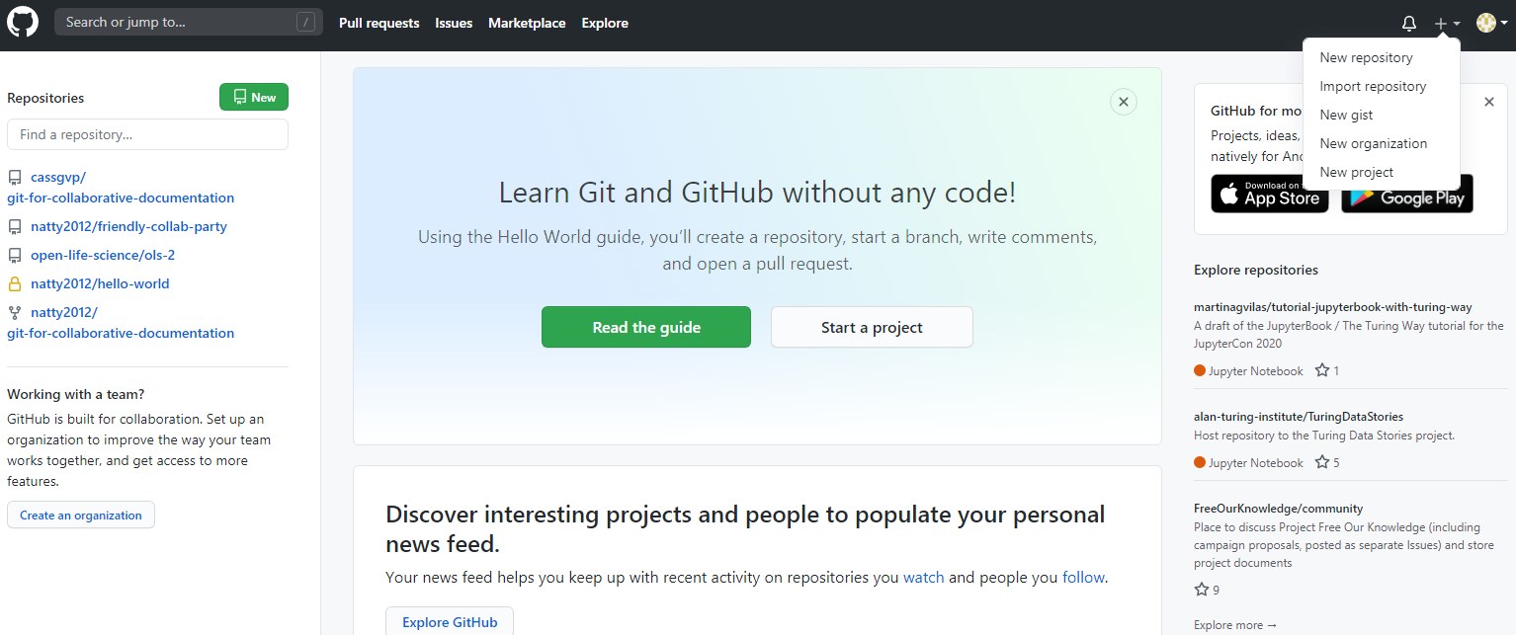
1.GitHub: how to create a repository (repo)

Slide 5
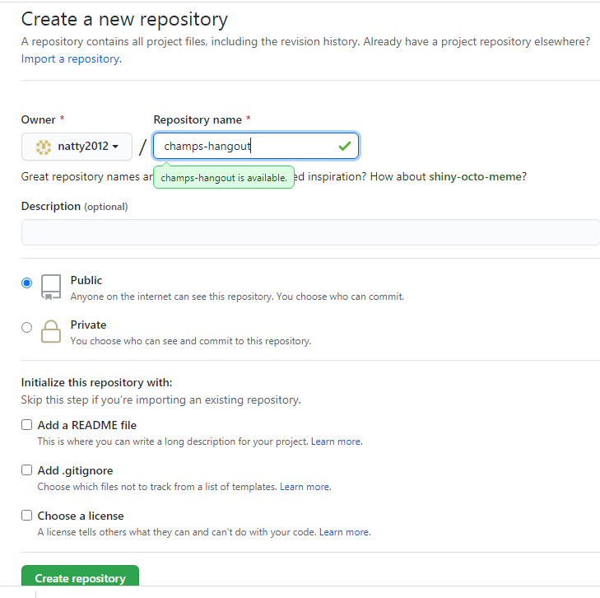
GitHub: a) how to create a repository (repo) & add a readme file
Type in a name (short & easy to remember)
Github will check for name availability

Slide 6
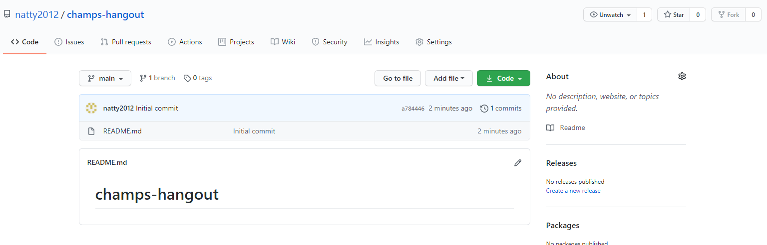
GitHub: b) how to edit a readme.md

Slide 7
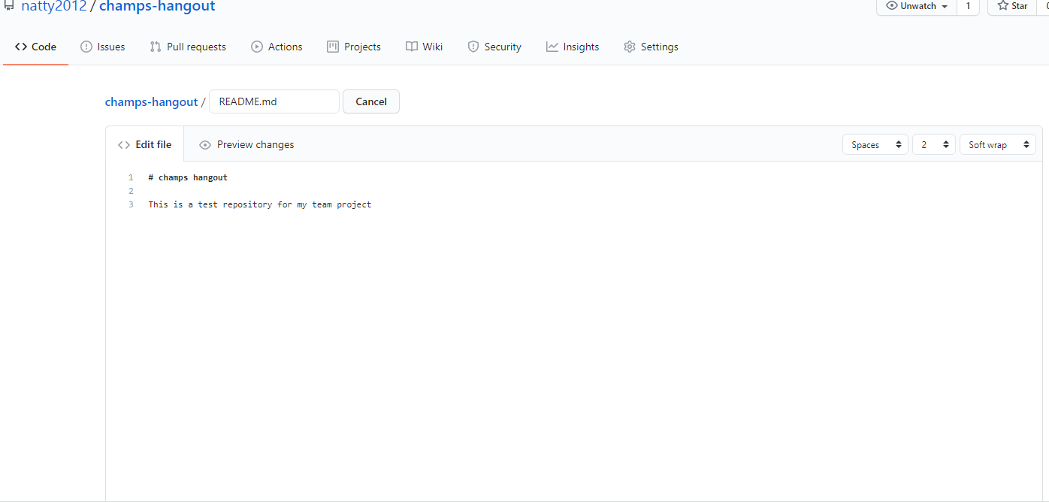
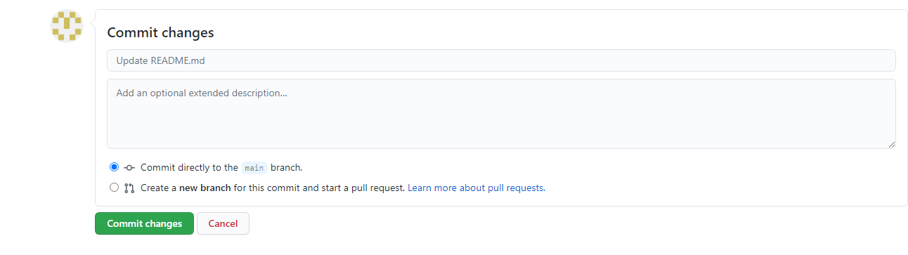
GitHub: c) commit changes (“save” changes)

Slide 8
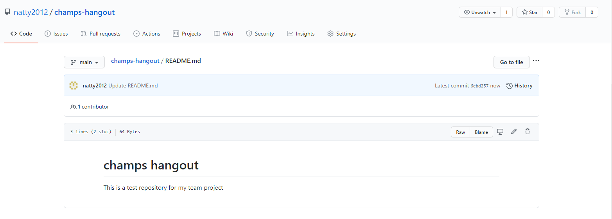
GitHub: d) final outcome after committing changes

Slide 9
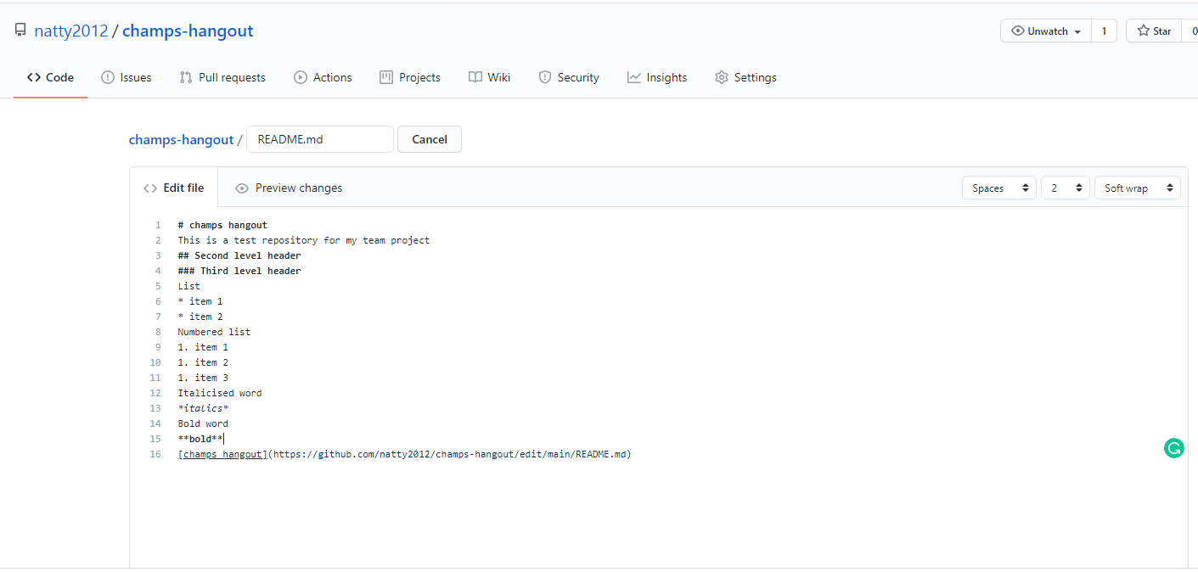
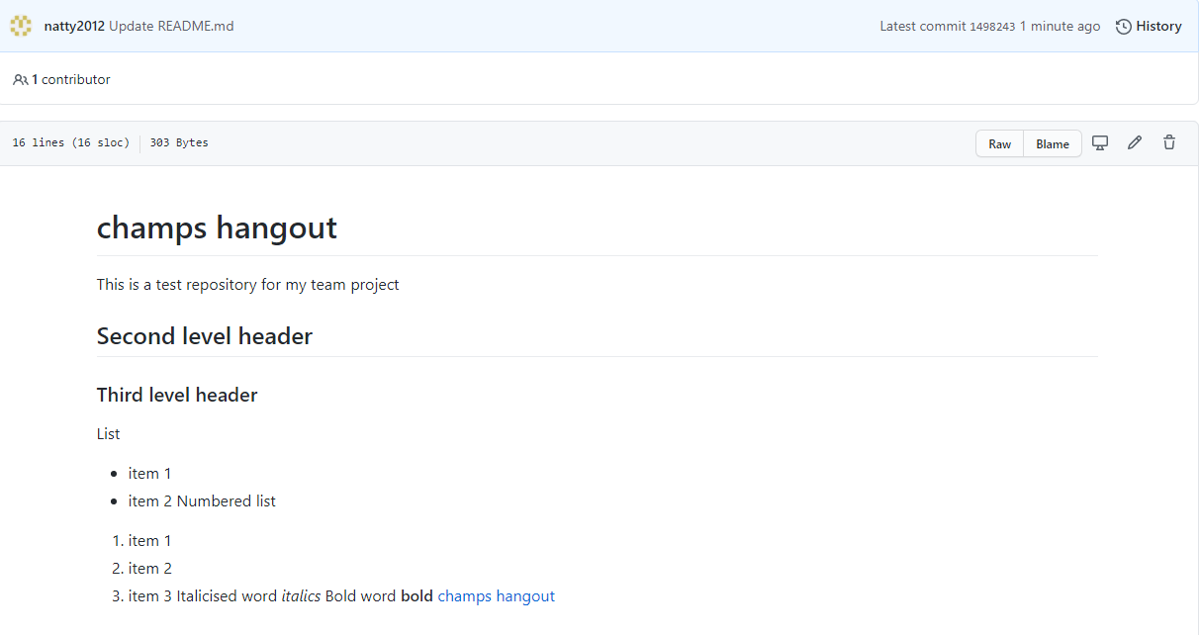
GitHub: e) Markdown syntax

Slide 10

Github: raw, blame, history

Slide 11
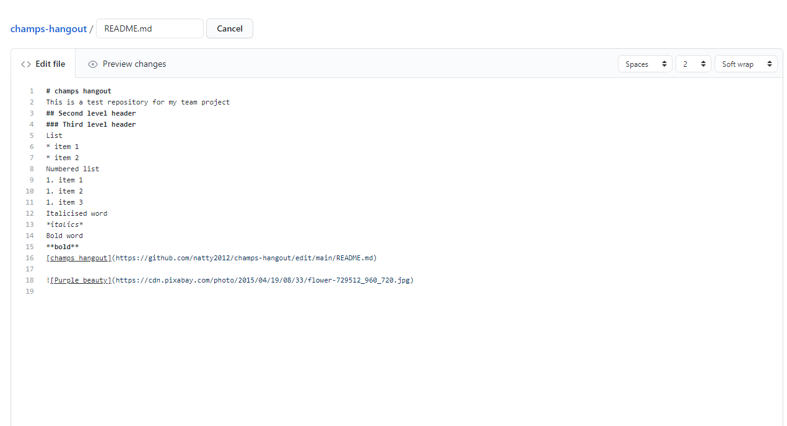
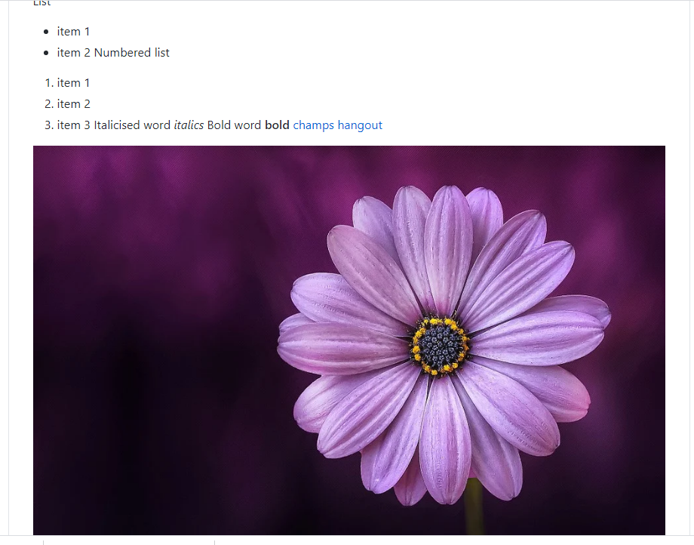
Github: adding an image

Slide 12
Thank you!: …to be continued

